Slide 1

AI / ML TRAINING · DAY 4 · PHASE C — DATA ENGINEERING & PREPARATION
Data Cleaning & Preprocessing
Part 2 — Preparing Data for ML
Encoding categoricals · feature scaling · feature engineering · the preprocessing pipeline
Unit U8 · Phase C · Day 4 (finishing U8 — cleaning was Part 1)

Slide 2






ORIENTATION
From clean data to model-ready data
The next step: Part 1 made the data correct. But models need numbers on comparable scales — so now we encode categories, scale features, and engineer new ones.
1
2
3
4
5
Why preprocess
Encoding
Scaling
Feature engineering
Pipelines
models only eat numbers
label & one-hot
normalise & standardise
create better inputs
do it without leakage
Recap: Part 1 fixed missing values, duplicates, types, outliers & text. Now we transform for the model.
U8 · Data Cleaning (Part 2)
2

Slide 3
1
MAKE IT NUMERIC
Encoding categorical data
Models do maths, not words. Turn categories into numbers — the right way for each kind.
Data Cleaning · Part 2 · Phase C · 01 / 06

Slide 4
Categorical data refers to variables that belong to distinct categories such as labels, names or types. Since most machine learning algorithms require numerical inputs, encoding categorical data to numerical data becomes important. Proper encoding ensures that models can interpret categorical variables effectively, leading to improved predictive accuracy and reduced bias.
Types of Categorical Data
1. Nominal Data: Nominal data consists of categories without any inherent order or ranking. These are simple labels used to classify data.
Example: 'Red', 'Blue', 'Green' (Car Color).
Encoding Options: One-Hot Encoding or Label Encoding, depending on the model's needs.
2. Ordinal Data: Ordinal data includes categories with a defined order or ranking, where the relationship between values is important.
Example: 'Low', 'Medium', 'High' (Car Engine Power).
Encoding Options: Ordinal Encoding.

Slide 5
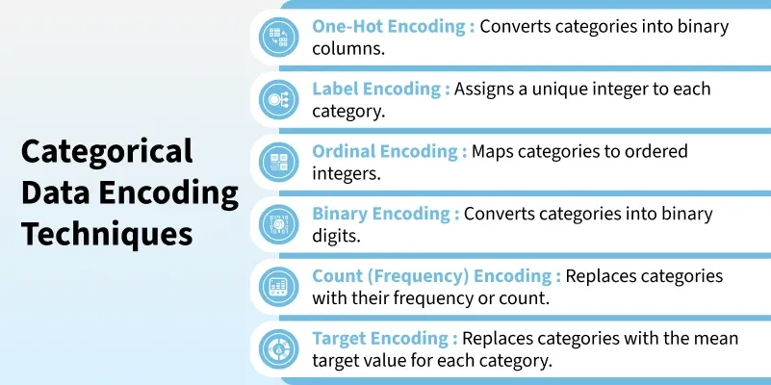
Techniques to perform Categorical Data Encoding

Slide 6
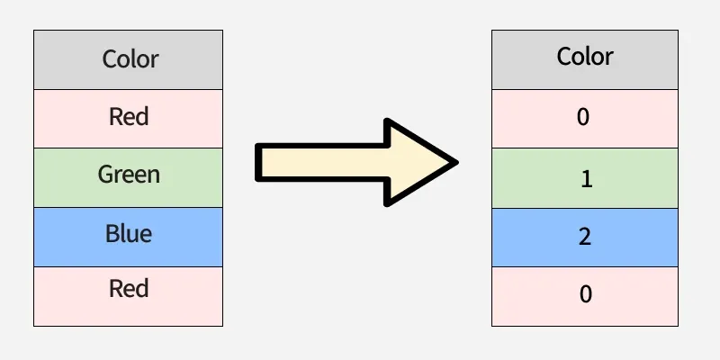
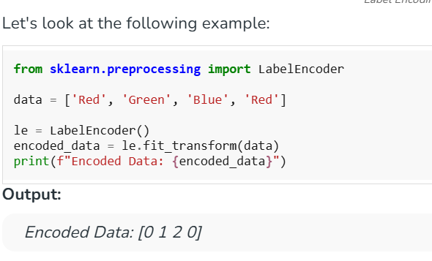
1. Label Encoding
Label Encoding assigns each category a unique integer. It is simple and memory-efficient but may unintentionally imply an order among categories when none exists.
Used in tree-based models like Decision Trees or XGBoost.
Pros: Simple and memory-efficient.
Cons: Introduces implicit order which may be misinterpreted by non-tree models when used with nominal data.

Slide 7
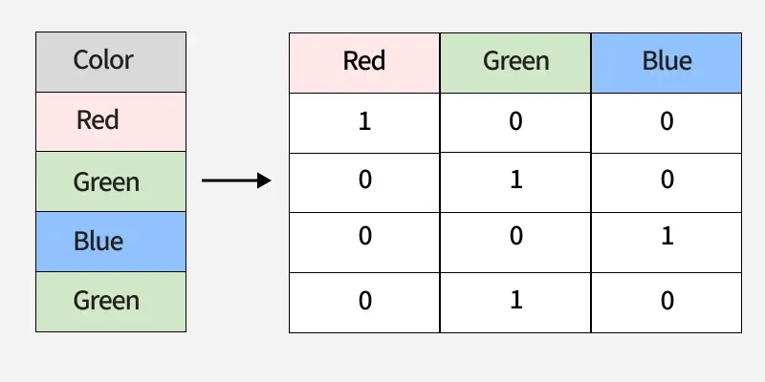
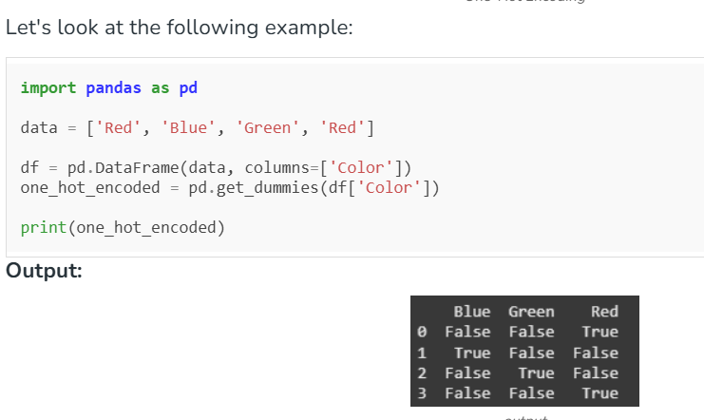
2. One-Hot Encoding
One-Hot Encoding converts categories into binary columns with each column representing one category. It prevents false ordering but can lead to high dimensionality if there are many unique values.
Used in linear models, logistic regression and neural networks.
Pros: Does not assume order; widely supported.
Cons: Can cause high dimensionality and sparse data when feature has many categories.

Slide 8
THE CORE CONSTRAINT
Models only understand numbers
The constraint: an algorithm computes distances, sums and gradients — so every input must be a number, and numbers must be on comparable scales.
Text categories
Different scales
Weak raw features
"red", "blue" → must become numbers (encoding)
age (0–100) vs income (0–1M) → must be rescaled
a date → day-of-week, is-weekend (engineering)
These three fixes — encode, scale, engineer — turn clean data into model-ready data.
U8 · Data Cleaning (Part 2)
4

Slide 9

CATEGORIES → NUMBERS
Label vs one-hot encoding
Label encoding
One-hot, visualised
red→0, green→1, blue→2 — one column. Use only for ORDERED categories (low<med<high).
color | is_red | is_green | is_blue
red | 1 | 0 | 0
green | 0 | 1 | 0
blue | 0 | 0 | 1
⚠ implies an order the model will believe
One-hot encoding
one 0/1 column per category — no false order. The default for UNORDERED categories.
✓ safe; watch out for too many categories
encode.py
pd.get_dummies(df, columns=['color']) # one-hot
# or sklearn: OneHotEncoder / LabelEncoder
IN-CLASS LAB One-hot encode an unordered column; label-encode an ordered one.
U8 · Data Cleaning (Part 2)
5

Slide 10
2
PUT IT ON ONE SCALE
Scaling, engineering & pipelines
Rescale features so none dominates, craft better inputs, and wire it all up without leaking test data.
Data Cleaning · Part 2 · Phase C · 02 / 06

Slide 11
ONE COMMON SCALE
Feature scaling
Normalisation (Min-Max)
Why scale at all?
rescales to a fixed [0, 1] range
Without scaling, income (0–1,000,000) dwarfs age (0–100).
Distance- & gradient-based models (KNN, SVM, neural nets, k-means) then treat income as all that matters.
(x − min) / (max − min)
good for bounded data, images
Standardisation (Z-score)
centres at mean 0, std 1
(x − μ) / σ
the common default; robust to ranges
Tree-based models (random forest, XGBoost) don't need it — but it never hurts.
IN-CLASS LAB Standardise and min-max scale a numeric column; compare the before/after ranges.
U8 · Data Cleaning (Part 2)
7

Slide 12
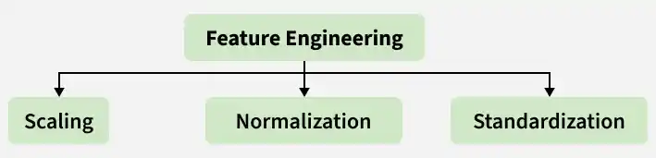
Feature Engineering - Scaling, Normalization and Standardization
Feature engineering is the process of creating, transforming or selecting important features from raw data to improve model performance. These features help the model capture useful patterns and relationships in the data.
It contributes to model building in the following ways:
Well-designed features help the model to learn complex patterns more effectively.
Removing noise and irrelevant information improves model prediction accuracy.
Focusing on meaningful features helps the model to generalize better and reduces overfitting.
Clear and informative features make the model easier to understand and interpret.

Slide 13
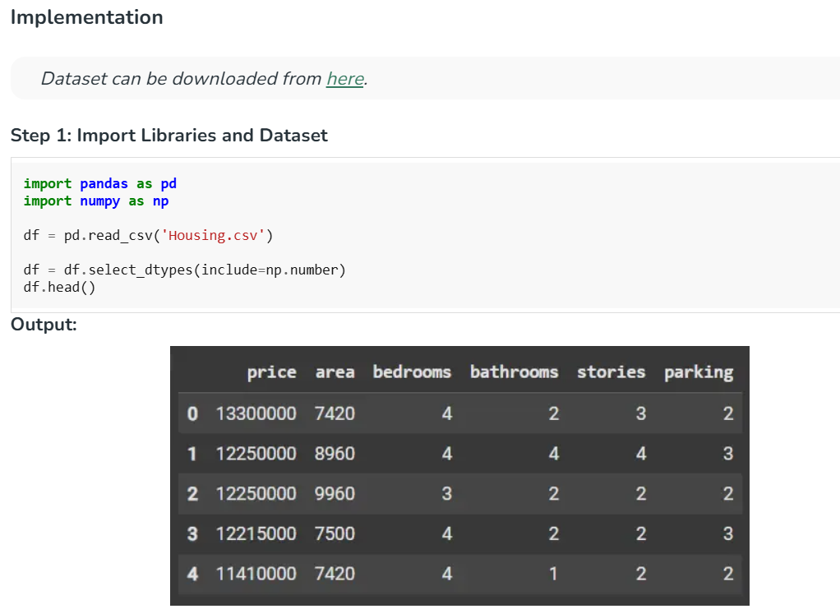

Slide 14
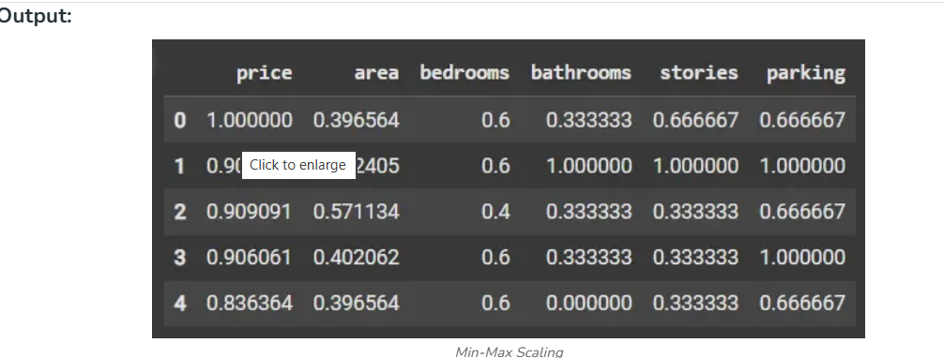
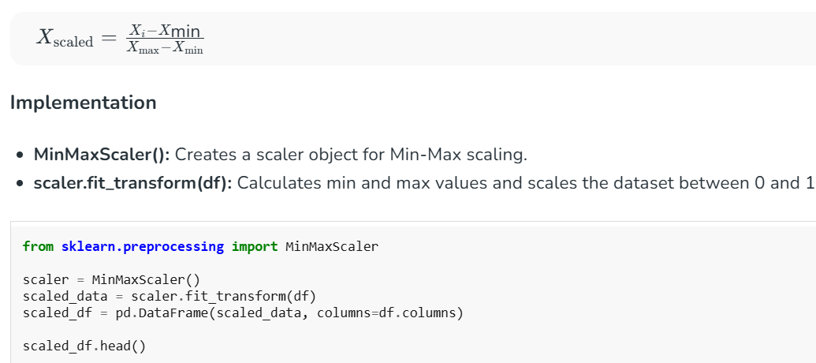
2. Min-Max Scaling
Min-Max Scaling rescales features by subtracting the minimum value and dividing by the difference between the maximum and minimum values. This usually maps feature values to the range 0 to 1 while preserving the original distribution.
Scaling Formula:

Slide 15

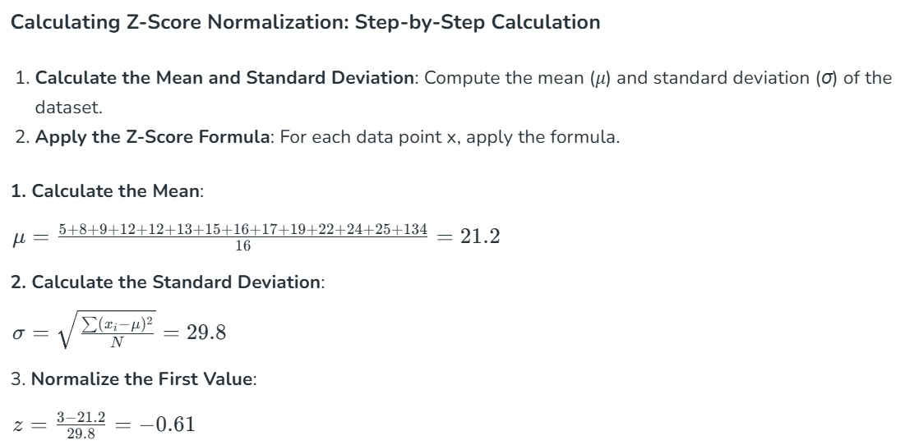
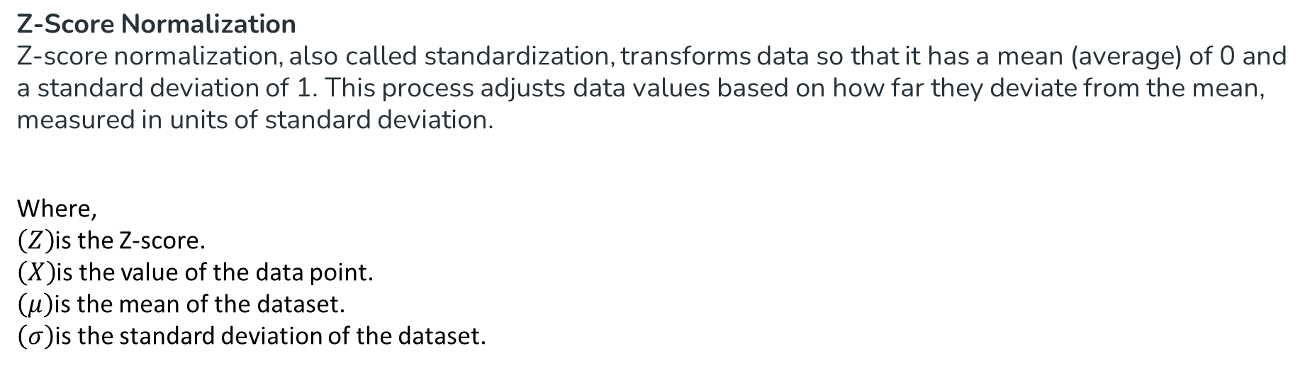
Z-Score Normalization
Z-score normalization, also called standardization, transforms data so that it has a mean (average) of 0 and a standard deviation of 1. This process adjusts data values based on how far they deviate from the mean, measured in units of standard deviation.
Where,
$\left(Z\right)$is the Z-score.
$\left(X\right)$is the value of the data point.
$\left(μ\right)$is the mean of the dataset.
$\left(σ\right)$is the standard deviation of the dataset.

Slide 16
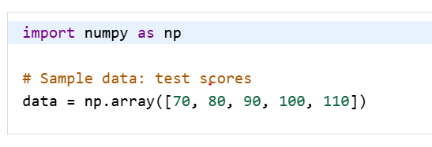
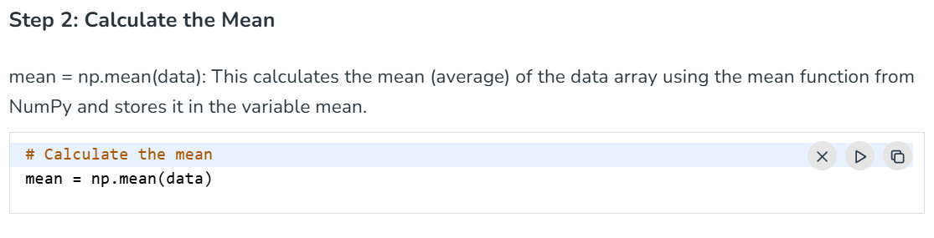

Slide 17
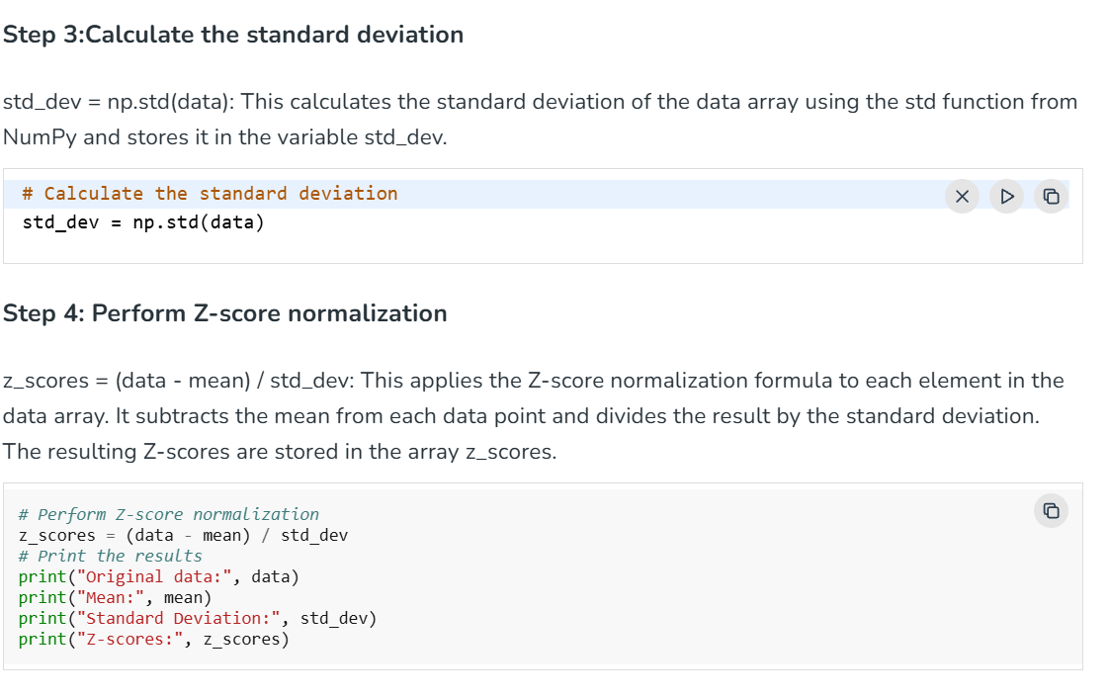
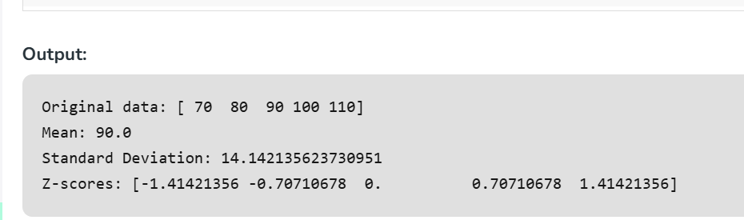

Slide 18

DO IT RIGHT
Scaling in code — and avoiding leakage
scale.py
from sklearn.preprocessing import StandardScaler
from sklearn.model_selection import train_test_split
X_train, X_test = train_test_split(X)
scaler = StandardScaler()
# fit ONLY on training data
X_train = scaler.fit_transform(X_train)
# reuse those stats on the test set
X_test = scaler.transform(X_test)
Avoid data leakage
Golden rule: fit scalers, encoders and imputers on training data only, then apply to test.
Fitting on all data lets test information leak in — inflating scores you can't reproduce in production.
IN-CLASS LAB Split first, then fit the scaler on train only and transform both sets.
U8 · Data Cleaning (Part 2)
8

Slide 19



CRAFT BETTER INPUTS
Feature engineering basics
The idea: create new columns that expose the signal more directly — often the biggest lever on model performance.
Extract from dates
Combine columns
Bin / bucket
Aggregate
date → day-of-week, month, is_weekend
height & weight → BMI; price & qty → total
age → child / adult / senior groups
per-customer mean spend, purchase count
Good features beat fancy models: domain knowledge encoded as columns often wins competitions.
IN-CLASS LAB Engineer 2 new features (e.g. extract day-of-week from a date; combine two columns).
U8 · Data Cleaning (Part 2)
9

Slide 20
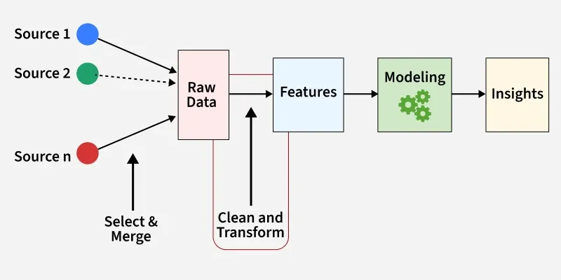
Feature Engineering is the process of selecting, creating or modifying features like input variables or data to help machine learning models learn patterns more effectively.
It involves transforming raw data into meaningful inputs that improve model accuracy and performance.
Importance of Feature Engineering
Improve accuracy: Choosing the right features helps the model learn better, leading to more accurate predictions.
Reduce overfitting: Using fewer, more important features helps the model avoid memorizing the data and perform better on new data.
Boost interpretability: Well-chosen features make it easier to understand how the model makes its predictions.
Enhance efficiency: Focusing on key features speeds up the model’s training and prediction process, saving time and resources.

Slide 21
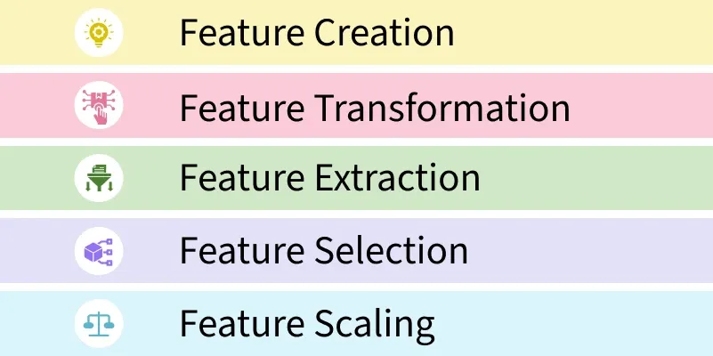
1. Feature Creation: Feature creation involves generating new features from domain knowledge or by observing patterns in the data. It can be:
Domain-specific: Created based on industry knowledge like business rules.
Data-driven: Derived by recognizing patterns in data.
Synthetic: Formed by combining existing features.
2. Feature Transformation: Transformation adjusts features to improve model learning:
Normalization & Scaling: Adjust the range of features for consistency.
Encoding: Converts categorical data to numerical form i.e one-hot encoding.
Mathematical transformations: Like logarithmic transformations for skewed data.

Slide 22
3. Feature Extraction: Transform existing features into a lower-dimensional or more informative representation (e.g., PCA).
Dimensionality reduction: Techniques like PCA reduce features while preserving important information.
Aggregation & Combination: Summing or averaging features to simplify the model.
4. Feature Selection: Feature selection involves choosing a subset of relevant features to use:
Filter methods: Based on statistical measures like correlation.
Wrapper methods: Select based on model performance.
Embedded methods: Feature selection integrated within model training.
5. Feature Scaling: Scaling ensures that all features contribute equally to the model:
Min-Max scaling: Rescales values to a fixed range like 0 to 1.
Standard scaling: Standardizes features to have mean 0 and variance 1

Slide 23
Steps in Feature Engineering
Feature engineering can vary depending on the specific problem but the general steps are:
Data Cleaning: Identify and correct errors or inconsistencies in the dataset to ensure data quality and reliability.
Data Transformation: Transform raw data into a format suitable for modeling including scaling, normalization and encoding.
Feature Extraction: Create new features by combining or deriving information from existing ones to provide more meaningful input to the model.
Feature Selection: Choose the most relevant features for the model using techniques like correlation analysis, mutual information and stepwise regression.
Feature Iteration: Continuously refine features based on model performance by adding, removing or modifying features for improvement.

Slide 24
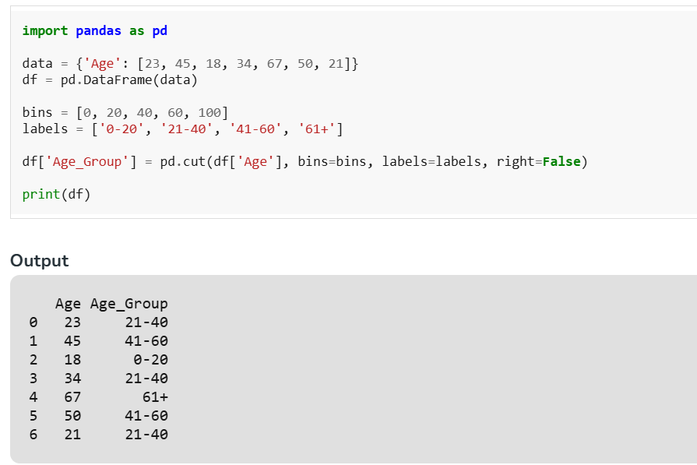
Common Techniques in Feature Engineering
One-Hot Encoding: One-Hot Encoding converts categorical variables into binary indicators, allowing them to be used by machine learning models.
Binning: Binning transforms continuous variables into discrete bins, making them categorical for easier analysis.

Slide 25



TIE IT ALL TOGETHER
The preprocessing pipeline
CLEAN
ENCODE
SCALE
ENGINEER
MODEL
Part 1: fix data
categories → numbers
common scale
new features
ready to train
pipeline.py
from sklearn.pipeline import Pipeline
pipe = Pipeline([('scale', StandardScaler()), ('model', LogisticRegression())])
pipe.fit(X_train, y_train) # scaling + model in one leak-free step
IN-CLASS LAB Wrap a scaler + a model in a scikit-learn Pipeline and fit it on the training set.
U8 · Data Cleaning (Part 2)
10

Slide 26

WRAP-UP
Recap, homework & what comes next
KEY TAKEAWAYS
HOMEWORK / SELF-PACED
UP NEXT — PHASE C
Models need numbers on comparable scales
One-hot unordered; label-encode ordered
Standardise or min-max scale features
Engineer features to expose the signal
Fit on train only — never leak test data
One-hot encode an unordered column
Label-encode an ordered column
Standardise & min-max scale a feature
Engineer 2 new features
Build a scaler + model Pipeline
U9
Exploratory Data Analysis — see patterns before modelling
★
U8 complete: data is clean & model-ready
The full picture: clean (Part 1) → encode → scale → engineer (Part 2). Now the data is finally ready to model.
U8 · Data Cleaning (Part 2)
11

